Slide 1

Reinforcement Learning for Multi-Agent Maze Solving
This presentation explores the application of Reinforcement Learning to solve a multi-agent maze-solving problem, showcasing the benefits of cooperation and dynamic goal selection.

Slide 2
Problem Statement
Two Agents
Goal
Two agents are tasked with finding their way out of a maze.
The objective is to reach their individual goals with the fewest steps possible.

Slide 3

Multi-Agent Reinforcement Learning
1
Key Idea
2
Agent-Environment Interaction
3
Information Sharing
Agents learn to cooperate and make optimal decisions.
Agents share information about their progress, improving efficiency.
Agents receive rewards based on actions and environment feedback.

Slide 4

Internal Reward Mechanism
Goal Selection
Internal Rewards
Dynamic Adaptation
Agents choose the goal with the shortest distance, based on shared information.
Agents receive internal rewards based on the progress of both agents.
Agents adjust their strategies based on the changing information.

Slide 5

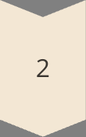
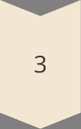

Algorithm Behavior and Training Process
Initialization
Two agents start with shared Q-table and independent performance metrics (tix).
Training Episodes
Agents select actions, interact with the environment, update Q-table, and potentially reach goals.
Goal Achievement
Agents update Tix, recalculate internal rewards, and share performance.
Post-Training
Performance visualization and execution of trained agents in maze navigation.
This process ensures individual autonomy in rewards while promoting shared knowledge and cooperative enhancement through tix sharing.

Slide 6
Scenario: Both Agents Reach Goals Simultaneously
Agent A
Agent B
Implications
Receives positive reward (1), marked as done, updates Tix, calculates internal reward based on performance improvement, and shares updated tix.
Receives positive reward (1), marked as done, updates Tix, independently calculates internal reward based on its own performance improvement, and shares updated tix.
Independent updates for each agent, enhanced cooperation through simultaneous tix sharing, potentially accelerating the overall learning process.

Slide 7
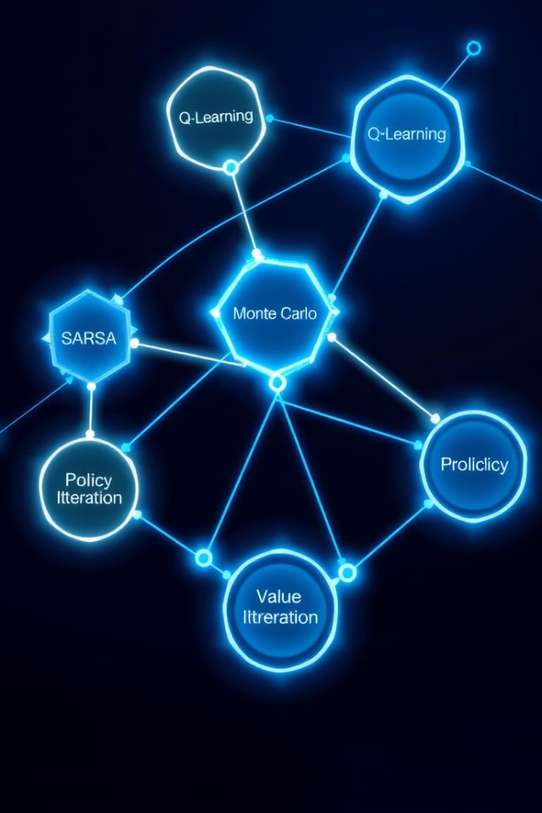




Algorithms Used
Q-Learning
SARSA
Model-free off-policy algorithm.
On-policy algorithm.
Monte Carlo
Policy Iteration
Value-based algorithm.
Model-based algorithm.

Slide 8
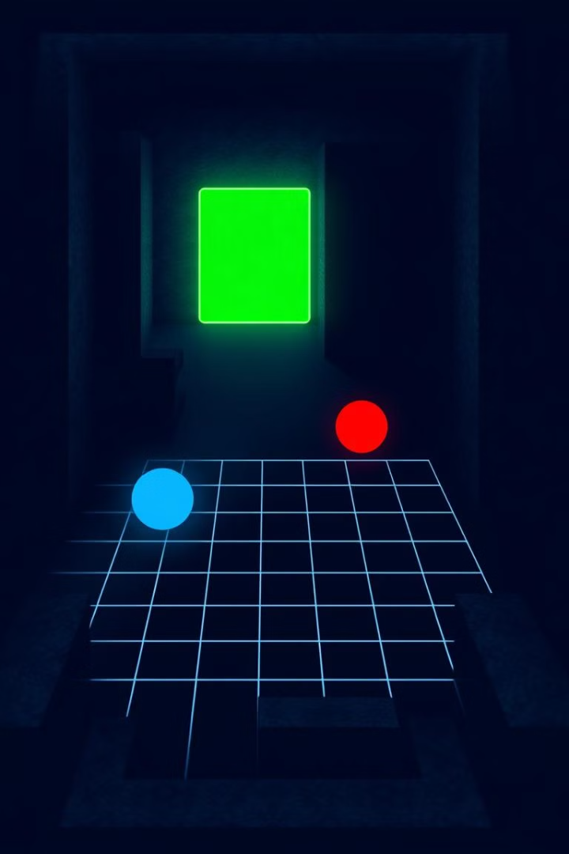
Experimental Setup
1
Maze Environment
A 10x10 grid with walls and defined start/goal positions.
2
Hyperparameters
Learning rate, discount factor, exploration rate, and delta.
3
Training Episodes
1000 episodes run to train the agents.

Slide 9
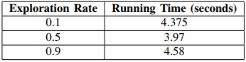
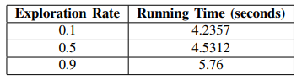
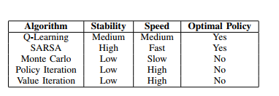
Results
1
SARSA
Most effective algorithm with the shortest training time.
2
Q-Learning
Effective, but requiring more training time than SARSA.
3
Other Algorithms
Ineffective due to high time and resource requirements.

Slide 10
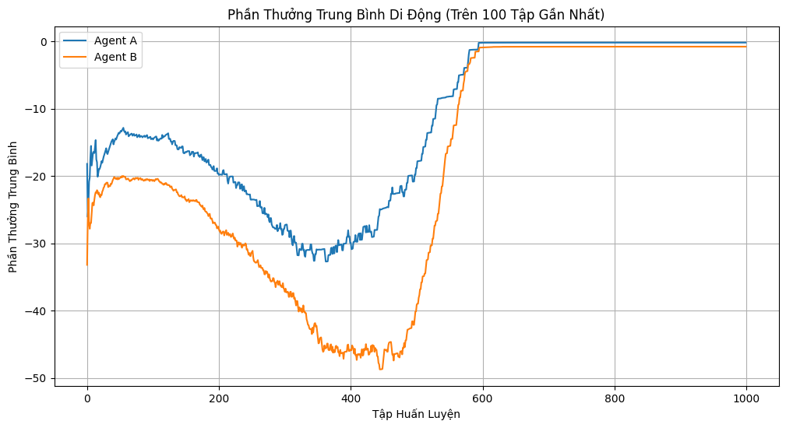
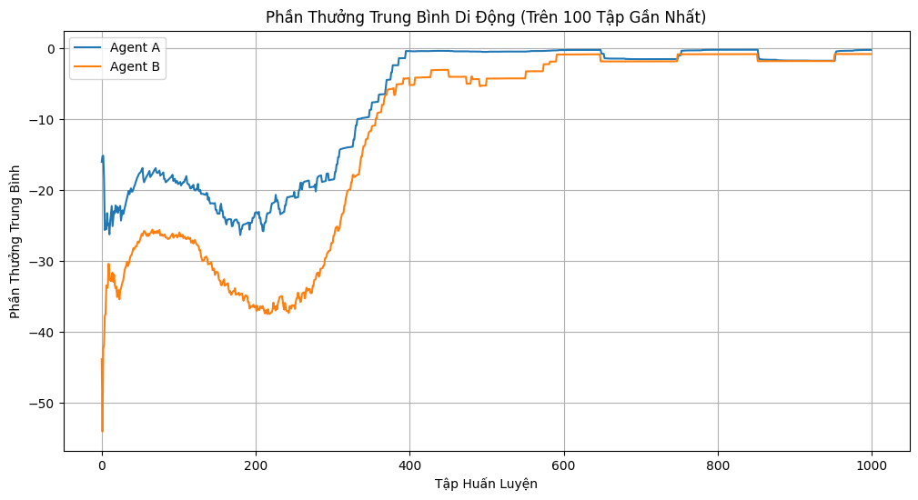
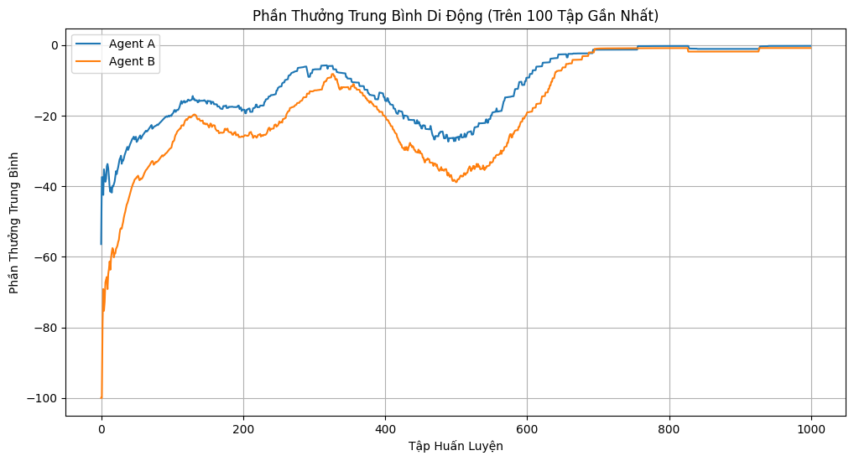
Q-Learning
e=0.1
e=0.5
e=0.9

Slide 11
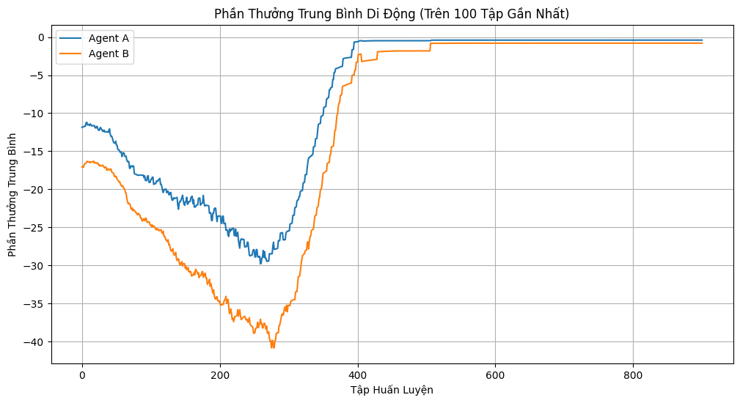
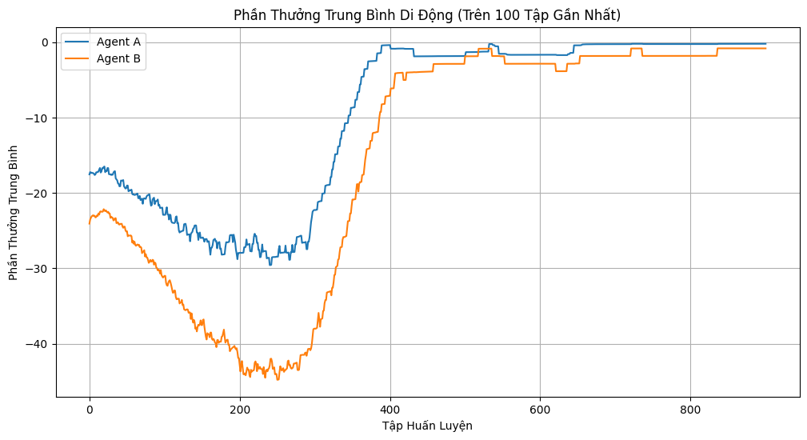
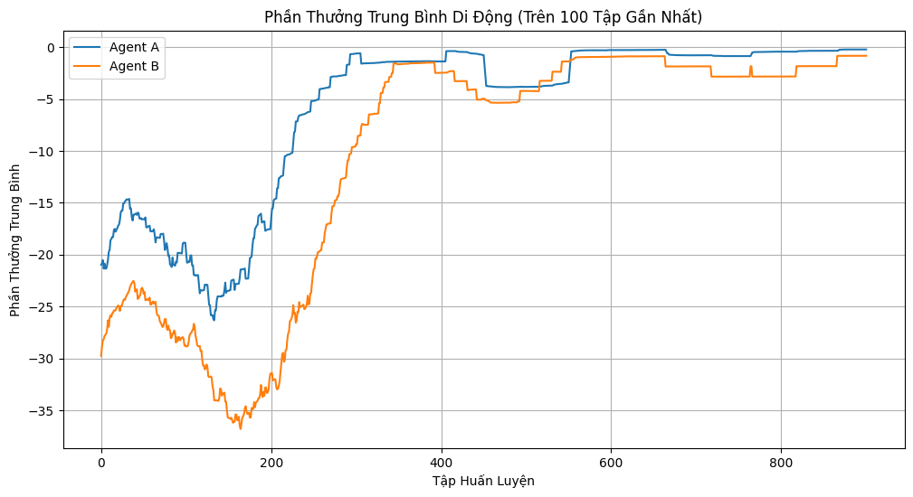
SARSA
e=0.1
e=0.5
e=0.9

Slide 12


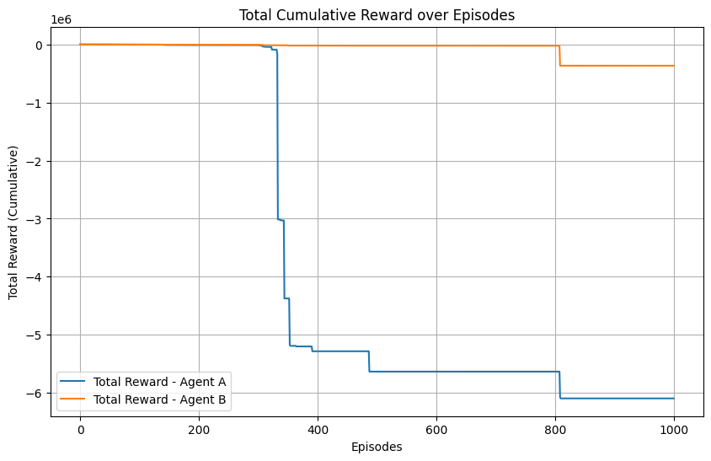



Monte carlo

Slide 13




Practical Implications and Future Applications
The internal reward mechanism and shared Q-table approach offer significant potential for scalability and flexibility in multi-agent reinforcement learning systems. This methodology can be extended to more than two agents, with each managing its internal rewards independently while benefiting from a collective knowledge base.
Scalability
Flexibility
Efficiency
Extendable to multiple agents, maintaining individual reward management and shared learning.
Adaptable reward structures to incentivize various performance improvements.
Enhanced learning outcomes through combined individual and shared experiences.
These features make the system highly adaptable to various complex learning environments and tasks, paving the way for advanced applications in robotics, autonomous systems, and artificial intelligence.

Slide 14



Future Work
Deep Reinforcement Learning
1
Investigating the use of DRL for more complex environments.
Dynamic Environments
2
Extending the framework to handle stochastic transitions and time-varying rewards.
Hybrid Methods
3
Combining traditional RL and DRL techniques.

Slide 15

Conclusion
This research successfully demonstrated the benefits of using MARL with an internal reward mechanism for solving multi-agent maze problems, highlighting the importance of cooperation, information sharing, and dynamic goal selection. While SARSA proved to be the most effective algorithm, further exploration of DRL and hybrid methods will continue to push the boundaries of MARL capabilities.

Slide 16


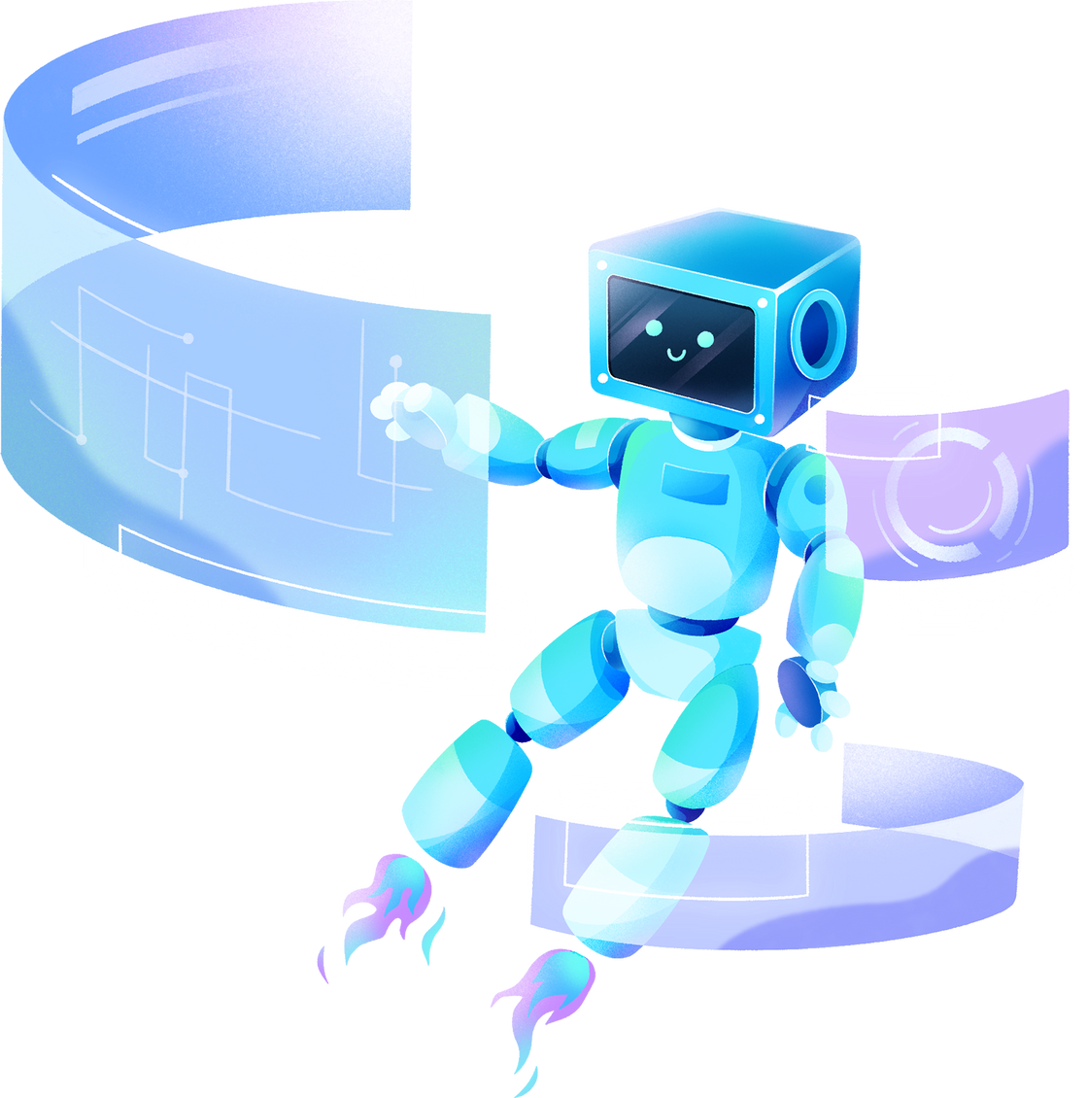
THANK YOU!

